Slide 1

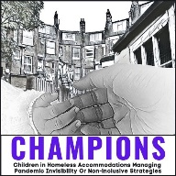







CHAMPIONS Project
This grant is funded by ESRC as part of UK Research and Innovation rapid response COVID 19.

Slide 2
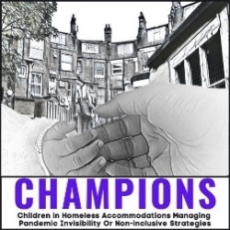
CHAMPIONS Project
Children in Homeless Accommodation Managing Pandemic Invisibility Or Non-inclusive Strategies
Principal Investigator: Prof. Monica Lakhanpaul
m.lakhanpaul@ucl.ac.uk
Co-Investigators:
Prof. Sushma Acquilla
Prof. Rob Aldridge
Dr Michelle Heys
Prof. Paula Lorgelly
Prof. Raghu Raghavan
Dr Marcella Ucci
Dr Nadzeya Svirydzenka
PhD student, Early Career Researcher, Research assistant/co-Lead (till 6/21):
Diana Margot Rosenthal
Research team:
Safya Benniche
Dr Kriss Fearon
Dr Margarita Garfias Royo
Dr Sorcha Mahony
Dr Kaushik Sarkar
Matt Williams
Students on project:
Daniela Cossio Martinez (UCL)
Gema Milla De La Fuente (UCL)
Christen van den Berghe (UCL)
Rosemary Roberts (UCL)
Arunima Shrestha (UCL)
Jingyuan Sun (UCL)
Priyam Deka (UCL)
Alfred Tu (UCL)
Hyka Shaikh (UCL)
Charlie Firth (DMU)
Katie Gent (DMU)
Project Leads:
University College London
De Montfort University Leicester
Project Partners:
Community Engagement Panel
The Children’s Society
EKAM Foundation
British Association for Community Child Health
Public Arts Health & Us
National Supporters
UCL Student Action Against Homelessness Society
Creative advisor:
Dr Kartik Sharma
This grant is funded by ESRC as part of UK Research and Innovation rapid response COVID 19.

Slide 3




A child engages with the world through all their senses
See
Smell
Hear
A home is not just the walls and roof.
Everything a child encounters impacts their development.
Stressful experiences have negative effects on their brain and mental health, whether that be
seeing their parents stressed
smelling unclean facilities
or hearing people shouting in the middle of the night
Notes:
Photo by MI PHAM on Unsplash

Slide 4
Impact of pandemic on existing inequalities
Lifestyle
Poverty
Environment
Resources
Less Active
More time inside
Restricted access to healthcare
0-5 years
brain development
Worse Diet
Smoke, mould, vermin
Delayed diagnosis/treatment
Weight gain
Vitamin
Deficiency
Poor mental health
Notes:
Photo by Sandy Millar on Unsplash
linking each child’s address to the UK government’s ten deciles of deprivation (calculated using seven indicators of income, employment, education, health, crime, access to housing and services, and living environment).
Using the residential address of the child as recorded in the NCMD, each household was linked to its corresponding English indices of deprivation (2019) and placed in one of 10 deciles, containing approximately the same number of people across England, with increasing measures of deprivation.
With 2 datasets (analysed in ‘cohorts’):
Cohort 1: Reported deaths. Main analysis based on deaths reported to the National Child Mortality Database (NCMD) (within 48hrs) from 1st April 2019 up to 31st March 2020
Cohort 2: Reviewed deaths. Deaths reported by ONS (death registration can take a long time in some cases, e.g., undergoing coroner’s investigation or inquests) and reviewed by a CDOP between 1st April 2019 and 31st March 2020. The deaths included in this cohort occurred at any time before 31st March 2020.
Methods:
- Poisson regression model was used to estimate the relative risk of death for each decile of deprivation. It was found that on average the relative risk of death overall increased by 10% for each increasing decile of deprivation.
- Thematic analysis of the circumstances of children’s deaths conducted on CDOP reports looking for key words relating to deprivation

Slide 5




CHAMPIONS Project
Children in Homeless Accommodation Managing Pandemic Invisibility Or Non-inclusive Strategies
What impact do we want to make?
Producing evidence to support tailored and locally acceptable health and wellbeing recommendations.
Strategic communication: Engage in regular dialogue and knowledge exchange with stakeholders to ensure findings are widely known and shared.
Empowering families: Delivering co-developed visual health messages for families on a web-based platform
Advocacy: Build cross-sector partnerships to facilitate informed policy and practice decisions on strategies for pandemic recovery and future planning.
This grant is funded by ESRC as part of UK Research and Innovation rapid response COVID 19.
Notes:
Aditya Romansa on Unsplash

Slide 6
Scoping review – non-financial interventions
Mobile outreach services:
Community-based primary healthcare
Mobile health technologies
Widely used to improve child health service use and coverage in refugee populations in Turkey and Palestine
Use of community health workers improved health outcomes, e.g., doubling malaria treatment in area of India
Nigeria: increase in fully-immunised children 17.8% to 49%
This grant is funded by ESRC as part of UK Research and Innovation rapid response COVID 19.

Slide 7
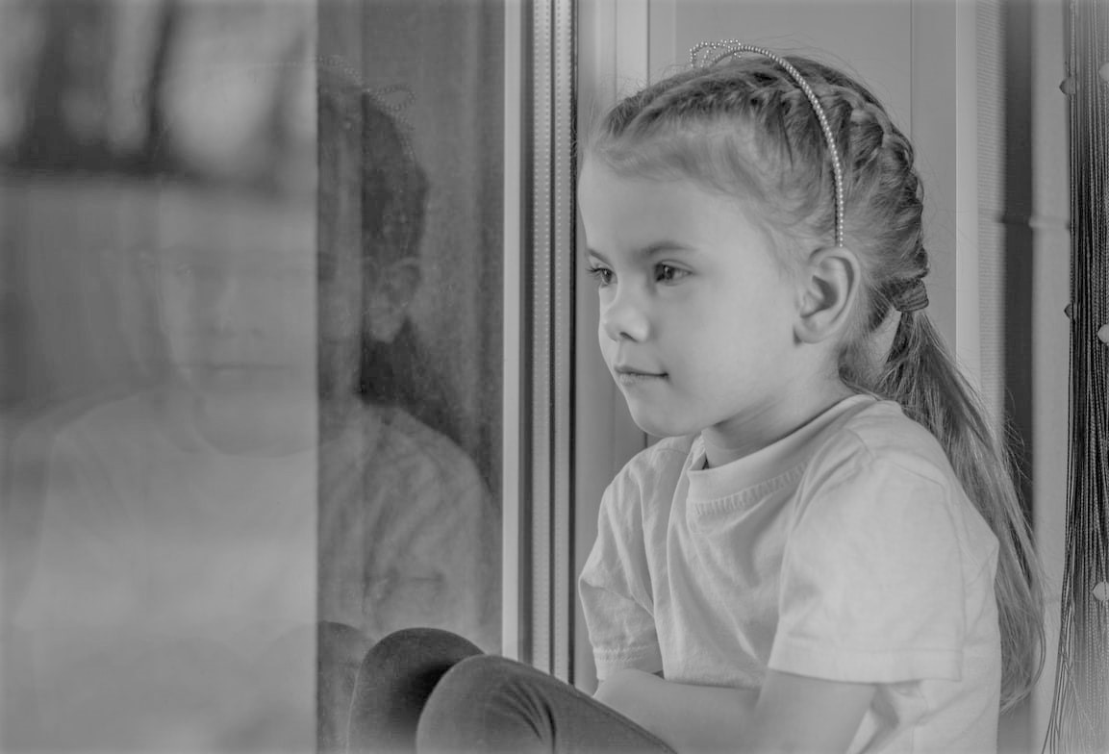
Challenges of COVID for children
TA impacts on Education
Difficulty concentrating
Long travel times
COVID impacts
Lack of kit and space for remote learning
Unable to wash clothes
Hunger
Children not ready for school
TA impacts on Health
Respiratory problems
COVID impacts
Disruption of health services
Further isolation
Developmental issues
Missed check-ups and missed milestones
Mental health problems

Slide 8

Families: food, nutrition, sanitation
Limited food availability
Keeping food clean
"She was of the age where she wouldn't really touch something and eat it, but had she been this age, I'm definite she would have eaten cockroach."
No consistency
"Now, whenever I tried to give him what I would feed him before, because he's not had it for a while, he wouldn't eat it."
No play or laundry outdoors
Shared space and hygiene
“There is no fridge, there is no washing machine. You share your bathroom with all sorts of people, it was really horrible for my daughter.”
"It's infested with mould and in COVID time I was thinking maybe my youngest daughter have... like, she's always wheezing"
"It was difficult to explain to them that the shelves were empty and that's why I couldn't get them their favourite snacks or foods."
Notes:
Photo by Siegfried Poepperl on Unsplash

Slide 9
Families: relationships and development
Overcrowding
Break in relationships
“My son cried when he walked through my grandad’s door because he hadn’t seen my grandad in six months, you know, he didn’t recognize him.”
Stress
"I found that all three of them actually started developing mood swings, withdrawn, temper tantrums, which wouldn't have happened before."
Noise and feeling unsafe
Not used to others
“She kept being sick, because of stress and lack of sleep.”
"My kids have to sleep on the floor because of me [...] Because I'm pregnant I sleep on the bed. My partner has to sleep with them on the floor."
“Even if some child comes to her and is trying to play with her, she's not interested. She runs away and just goes and plays on her own. It's what she's used to.”
"We have to stay in our room. Because she never plays like that, she thinks we are punishing her."

Slide 10
Professionals: challenges of COVID
Virtual appointments
Limited options
Data sharing
Dealing with basic needs
Different practices around notifying and handover between LAs – families get lost
Parents have a choice of what to show – don't see whole situation
Barriers to primary care -> barriers to other support
Support with benefits, food banks, baby banks
Often provided by charities – sustainability?
Importance of soft skills – persuasion, negotiation
Permanent homes not available – staff are supporting families to cope long term in challenging situations
Referrals harder as staff working from home, long waits

Slide 11

Findings: Children's mental health
She was not in nursery and the pandemic as well, it has affected her mentally, and her wellbeing in general... she started isolating herself from other kids. ... She's now a child that has social anxiety.
Impact of isolation (bonding, stimulation and play)
  Norm is being with parent all the time, anxiety about being left
  Anxiety about being around other children, adults
  Needs to learn to play and share with others
  Restricted access to parks, play spaces – indoors even more
Link with parental mental health
  Difficulty in accessing mental health support
How do you overcome these issues?
  Depends on population and previous circumstances (e.g., from home to refuge, child may be doing better than before)
  Who needs to be trained and what training is it?
We used to stay in bed till, like, twelve. And she used to sit there watching TV on her own or doing stuff on her own as well, because I didn't have the motivation.
He doesn't even let his dad play with him sometimes.
When [school] stopped they noticed more and more the conditions they were living in.

Slide 12

Findings
House-hunting and moving home – stressful and tiring, may also be done without parent input
Emotional and psychological health
Fear, boredom and insecurity – stress of COVID and TA risks, precarity of TA
Social and relational life
Family in the household – tensions from cramped accommodation
Wider family – missing wider family but sometimes having more contact (online)
Friends – TA and lockdowns cause disruption in friendships
Educational life
Hobbies and leisure
Managing daily life
Household chores and care – more time spent at home so more time cleaning shared spaces and looking after siblings
Digital access - families interviewed had devices but internet access was a challenge
Remote advantages – remote learning avoided a long commute to school
Adaptation in COVID - taking on new hobbies and making use of what space they had
"Especially when we were at the hotel, I had to like, wake up, go to school, come back, stay in that room, revise in that room, then go to sleep in it again. It didn’t feel like I was really living. Not like a normal kid…" - 13 yo girl

Slide 13
Report: 10-19 year olds living in temporary accommodation during COVID
The Children's Society, 2022
"a lot of people my age are just giving up, it’s like they’re giving up cos it seems that the government doesn’t care about helping us to get somewhere successful in our later lives."
Conclusions
Children are resilient and cope creatively but want the situation to change – they are aware of the inequalities.
Asks:
Support for learning – laptops, internet access, different online teaching style
Greater support with rent for people who can't pay due to job loss or illness with COVID
Ensure children have the resources to make the best of their skills
Support to aid social mobility and give young people hope and the ability to achieve their ambitions
"For example, I’m 16 and I’m already wondering ‘how am I even gonna pay for my university fees to do what I want to do in the future’? I don’t even have a proper place to live right now."
"They’re focusing on issues that to be honest shouldn't take priority over families with children, especially single parents, and families who are struggling like we are. So, yes. That’s what I think"

Slide 14
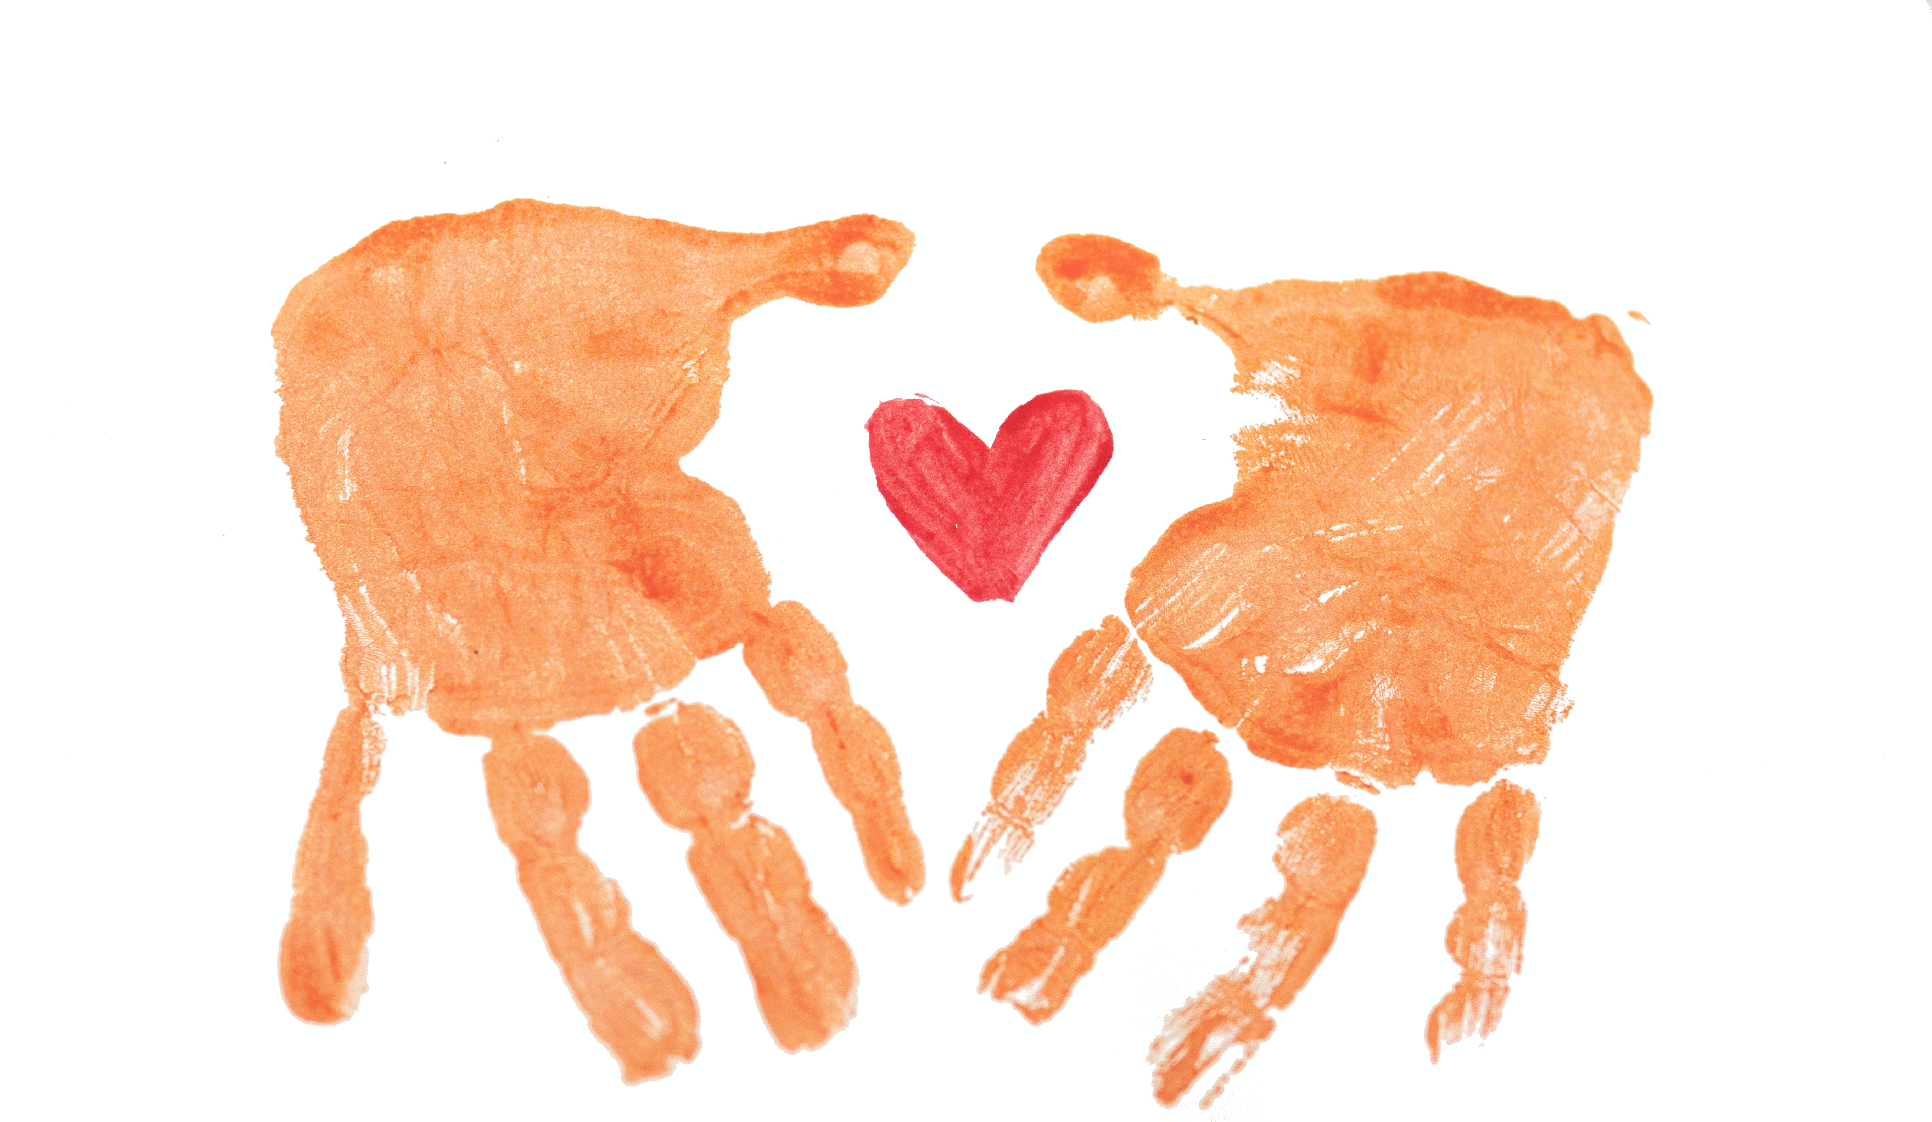
Findings: Supporting families - what helped?
Difficult to separate issues caused by TA and by COVID
Families are coping and surviving - not thriving
Making the best of a difficult situation
COVID removed many support options
Keeping a routine – even if it's different from before
Building and maintaining social relationships
Internet and phone access
Regular calls from family, friends and volunteers
Mutual support (depending on the context)
Support services
Access to support services which come to them
Keep track of people – isolation carries risks
Being able to stick to the regulations
Cost and availability of sanitiser, tests, laundry, masks
My family, I think it's pushed us closer. ... Because sometimes we don't see eye to eye and then we argue and then we're like, OK maybe we're not meant to be together. But then we realise, hang on a sec, we've been through this whole two years together.
There are so many free things that happened during COVID, a lot of free educational resources, some exercises I was able to tap into, so that was how we were able to manage.
They had access to laptops and tablets but that's because the charity was there, offering us support.
We all support each other when we're struggling, and especially with the children as well. [Refuge]
Just try to keep the routines as normal as possible.
Notes:
Photo by Rod Long on Unsplash

Slide 15
Creative outputs to raise awareness
Creative arts engages with the public
Raises awareness of both the issues surrounding TA, and the CHAMPIONS Project
Children's art workshops
Partnered with Graffwerks, a nationally recognised street art team, local authorities and other organisations
Children used art to tell us about their experiences of lockdown
Community stories
Open invite to share stories with us to promote dialogue around TA
Developing video stories with participants based on their words, audio, video and pictures
Digital stories

Slide 16
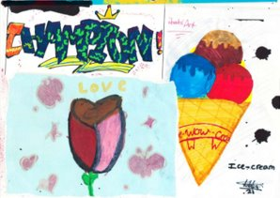
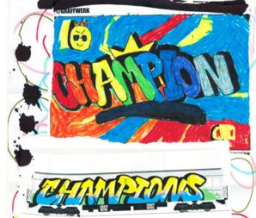
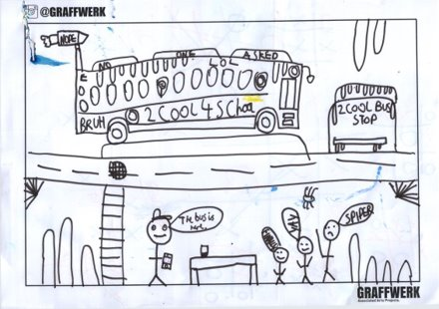

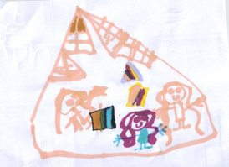
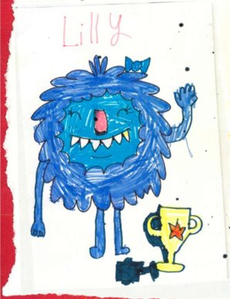
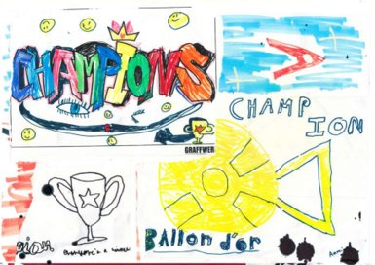

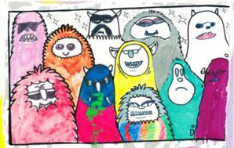
Children's art workshops
Graffwerk led a series of art workshops for children in Newham, London
Creative ways to support young people to express the importance of the home, young people's dreams for the future

Slide 17





CHAMPIONS Project: The future
This grant is funded by ESRC as part of UK Research and Innovation rapid response COVID 19.

Slide 18

CHAMPIONS Project
Children in Homeless Accommodation Managing Pandemic Invisibility Or Non-inclusive Strategies
We say:
All children should be safe, healthy, and educated (SHE)
They say:
We are not invisible, so don’t leave us behind
No child should go hungry, cold, or deprived of learning - all children should have a home
CHAMPIONS (2022)
This grant is funded by ESRC as part of UK Research and Innovation rapid response COVID 19.

